Slide 1
NE 763: Advanced Reactor Materials
Fall 2025
Dr. Benjamin Beeler

Slide 2
Last Time
TRISO particle intro, evolution into current TRISO design
Different layers and their roles
kernel, buffer, IPyC, SiC, OPyC
Fuel kernel – UO2 and UCO
UO2 retains fission products, but generates CO
UC2 limits CO formation, but poorly retains fission products
Fission products
Oxygen potential controls which compounds form, transitioning UC into UO2, while some FPs form oxides and other carbides

Slide 3
Silicon Carbide

Slide 4
Silicon Carbide (SiC)
SiC is a very hard and strong non-oxide ceramic that possesses unique thermal and electronic properties
Polycrystalline SiC has a strength of 15 GPa and has excellent creep resistance
SiC’s upper limit of stability is around 2500C and has a melting temperature of around 2830C
SiC also has excellent thermal conductivity
SiC is a highly covalent material that forms tetrahedra that are centered around either carbon or silicon atoms
β-SiC takes the diamond cubic structure with half of the carbons being replaced with silicon; this is a very stable structure that is conducive to phononic heat conduction

Slide 5
Silicon Carbide (SiC)
Silicon carbide (SiC) has been studied and utilized in nuclear systems for decades, primarily as the micro pressure vessel for high-temperature gas-cooled reactor fuels
The SiC must be strong enough to withstand the pressure buildup from the fission product gas liberated and CO produced
The SiC layer must withstand chemical attack from metallic fission products such as palladium
The SiC must be able to handle the mechanical loads derived from irradiation-induced dimensional changes occurring in the PyC layers
The SiC must maintain its properties during irradiation

Slide 6
Radiation Effects in SiC
The neutron-induced swelling of SiC has been well studied for low and intermediate temperatures (up to 1000 C)
It is well understood that the presence of significant second phases and/or poorly crystallized phases in these materials leads to unstable behavior under neutron irradiation
High purity, stoichiometric, near-theoretical density SiC can show excellent radiation resistance
Here I will be talking about the good SiC, assuming that the fabrication process has produced appropriately clean coatings

Slide 7
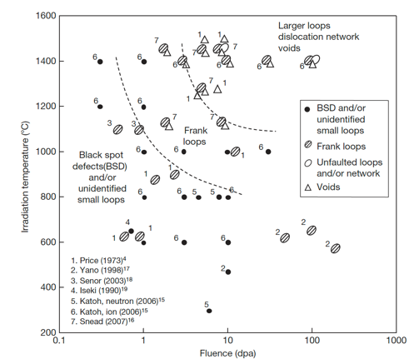
Radiation Effects in SiC
The microstructural evolution map is shown on the right
Different types of defects form at different temperatures
Swelling behavior of SiC is relatively well understood
But the contribution of the defects themselves to the swelling in SiC is not well understood

Slide 8
Low T Radiation Effects in SiC
Below 400 K, neutron irradiated SiC microstructure is described as black spot defects, which are most likely clusters of self-interstitial atoms
For irradiation temperatures less than about 423 K, accumulation of strain due to the irradiation-produced defects can exceed a critical level above which the crystal becomes amorphous
The swelling under self-ion irradiation increases logarithmically with dose until amorphization occurs
The swelling of neutron- and ion-amorphized SiC has been reported to be as high as 10.8% at 343K

Slide 9
Low-Med T Radiation Effects in SiC
Above the critical amorphization temperature (423 K), the swelling increases logarithmically with dose until it reaches saturation
The saturation level decreases with increasing irradiation temperature
The dose exponents of swelling during the log period are often close to 2/3, in line with assumptions based on interstitial clusters
This temperature regime is referred to as the point-defect swelling regime and goes from critical amorphization temperature to about 1273 K
Tirr=300 C, 6 dpa
Dot number density 2.2e+24m-3
Mean dot diameter=1nm
Tirr= 800 C, 7.7 dpa
Loop number density 3.3e+23m-3
Mean loop diameter = 3.0 nm

Slide 10
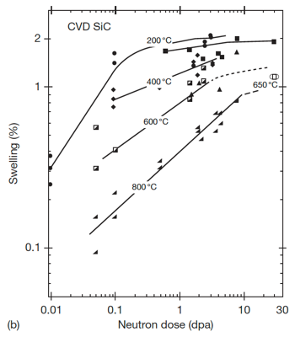

Saturation Swelling in SiC
Log swelling vs dose shown at right for CVD SiC irradiated in HFIR
The swelling of SiC is highly temperature dependent
at 1 dpa, saturation values from 200 C to 800 C vary by a factor of 5
The decrease in saturation with increasing T is due to increased recombination of defects
Swelling saturates at relatively low doses, less than 10 dpa

Slide 11
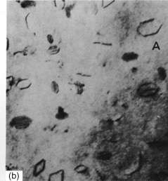
High T Radiation Effects in SiC
Above 1000C, Frank loops of the interstitial type become the dominant defects observed by TEM
Interstitial Frank loops are faulted, in that they include a stacking fault
Consequently, these loops cannot glide and will not move under an applied stress or temperature, and are therefore considered as sessile
At high temperature, the development of Frank loops into dislocation networks through unfaulting reactions at high doses is reported
Frank loops in Al

Slide 12
High T Radiation Effects in SiC
The volume associated with dislocation loops in irradiated SiC has been estimated to be on the order of 0.1%
At high T (greater than about 1250 K) vacancies are sufficiently mobile and vacancy clusters can be formed
This high T regime is the void swelling regime
1130 C, 1.8 dpa
1130 C, 8.5 dpa
1280 C, 5.0 dpa
1450 C, 1.8 dpa
1450 C, 5.0 dpa
1450 C, 8.5 dpa
Evolution of voids in high-temperature irradiated CVD SiC

Slide 13
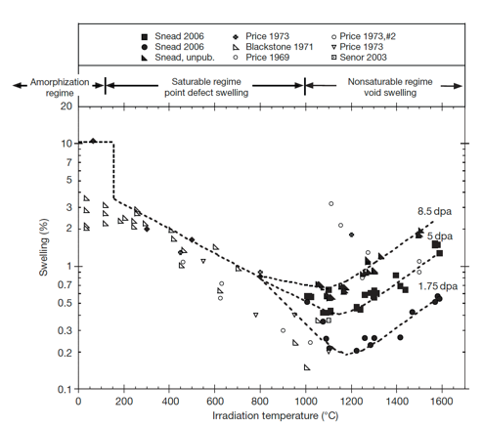
Irradiation-Induced Swelling in SiC
The transition from point-defect saturated swelling to void swelling occurs above 1000C
Void swelling increases as a function of dose, and is not known to saturate
The swelling near the critical amorphization temperature is described as the differential strain between point defects or small defect clusters

Slide 14
Irradiation-Induced Swelling in SiC
Above the critical amorphization temperature, the number of defects surviving recombination is reduced and the mobility of both silicon and carbon interstitials becomes significant
Above 1000 C microstructural studies have noted the presence of both Frank loops and tiny voids, indicating limited mobility of vacancies
The max irradiation temperature shown is 0.65 T_{melt}

Slide 15
Irradiation-Induced Swelling in SiC
In typical fcc metal systems void swelling typically begins at ~0.35Tm, goes through a maximum value, and decreases to nil swelling by ~0.55Tm
The voids in SiC are continuing to grow in SiC irradiated to 1773 K, thus the energies for diffusion of either the Si or C vacancy or both must be quite high
This has been confirmed through DFT methods
It is unclear how swelling will increase as a function of dose above 10 dpa

Slide 16
Recap of SiC Irradiation Defects
below 423 K, SiC can amorphize, can have fairly high swelling rates
at 423-1273 K, point defect swelling regime
black spot defects are the main types of defects
cause swelling which saturates, the level of which is inversely proportional to T
above 1273 K, we get Frank loops and voids
void swelling regime
does not saturate, increases with dose and with T

Slide 17
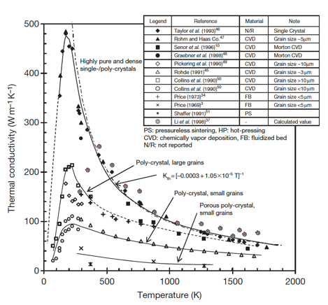
Thermal Conductivity Degradation
SiC is a ceramic with a band gap, and thus thermal conductivity is based on phonons
The conduction of heat can be generally described by the strength of the individual contributors to phonon scattering: grain boundary scattering; phonon–phonon interaction; and defect scattering
Each of these types occurs at differing phonon frequencies and can be considered separable

Slide 18
Thermal Conductivity Degradation
The unirradiated k_{th} is highly dependent upon initial microstructure and temperature
Initial microstructure can be tailored, but the temperature dependence cannot be removed
For reference, Zr thermal conductivity is about 22 W/m-K at 1000 K

Slide 19
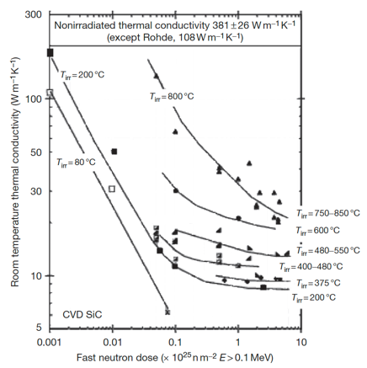
Thermal Conductivity Degradation
At low temperatures irradiation produces simple defects and defect clusters that very effectively scatter phonons
In this case, defect scattering quickly dominates, with saturation thermal conductivity typically achieved by a few dpa
Defect scattering is sufficiently present to eliminate the temperature dependence

Slide 20
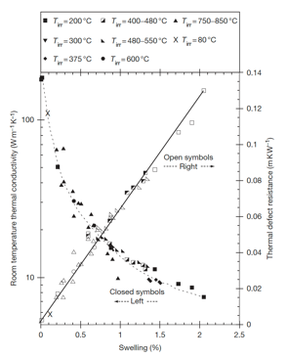
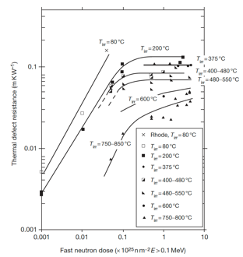
Thermal Conductivity Degradation
The thermal defect resistance is defined as the difference between the reciprocals of the irradiated and nonirradiated thermal conductivity (1/K_{rd} = 1/K_{irr} – 1/K_{nonirr})
This term can be related directly to the defect type and concentration present in irradiated ceramics
The thermal defect resistance is directly proportional to the irradiation-induced swelling in SiC
This allows an indirect determination of thermal conductivity by measurement of the density change in the TRISO SiC shell

Slide 21
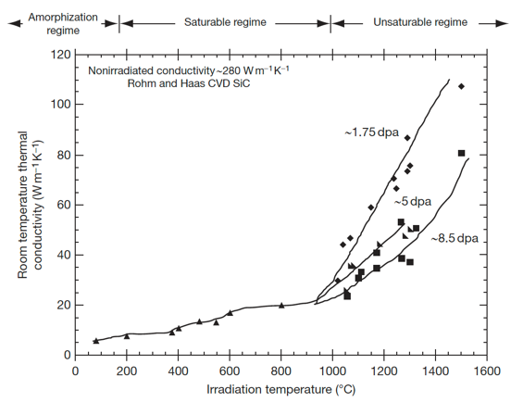
Thermal Conductivity Degradation
In the high temperature void swelling regime, thermal conductivity degradation is not expected to saturate, as voids continue to grow and scatter phonons
Additionally, the linear relationship between swelling and thermal defect resistance does not exist at high temperature
Generally, void swelling does not degrade thermal conductivity as severely as point defects, but data at high T is quite limited

